Slide 1
Introduction to Becoming a
CAP Pilot
Jeffco Squadron
Civil Air Patrol

Slide 2
Pilot Application Process
Must have high-performance endorsement
Complete CAPR 60-1 annual exam
Complete RMR pilot application
Sign Statement of Understanding
Complete CAPF 5 (and check ride)
Complete at least one aircraft questionnaire
100 hrs. logged total time

Slide 3
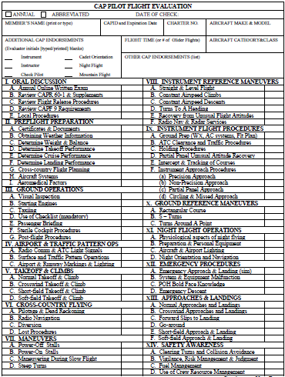
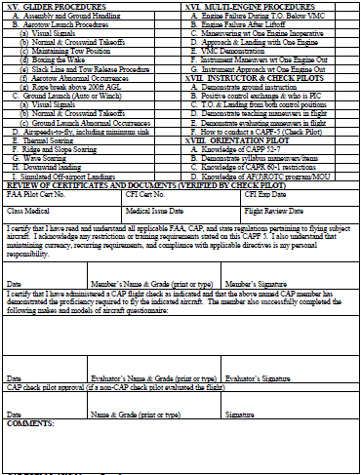
CAP Form 5
Notes:
You will be expected to perform maneuvers according to the level of your pilot certificate. It’s a full PTS checkride, not just an FBO rental checkout. Technically you are supposed to be current in ASEL (BFR, 90 days TOL) while taking the checkride.

Slide 4
Limitations
Cannot fly non-CAP members
Cannot fly out of state (there are some exceptions)
Cannot keep plane overnight (there are some exceptions)
Cannot fly for reward or hire
Cannot land off-airport (no dirt/grass runways)

Slide 5
After your CAPF 5 check ride
Obtain Emergency Services (ES) qualifications, if you haven’t already
Orientation ride pilot “O-ride Pilot” (200 hrs PIC)
Transport mission pilot “TMP” (150 hrs PIC, 50 X-C)
Mission Pilot “MP” (200 hrs PIC)
  MP allows you to seek more ratings through CAP
Notes:
Orientation Pilot for CAP Cadets, AFJROTC Cadets, Senior ROTC cadets
Missions include search and rescue, disaster relief, photo recon, VIP transport, fire observation, etc

Slide 6
Aircraft
N594CP
  2009 C-182T
  IO-540
  50 gallons mission fuel to allow a crew of 3
  GW: 3100 takeoff weight; 2950 landing weight
N9669X
  1986 C-182R
  O-470
  60 gallons mission fuel
  GW: 3100 takeoff weight; 2950 landing weight

Slide 7
Hangar
Jeffco Squadron manages N594CP in Hangar 51
Boulder Squadron manages N9889X in Hangar 42
Hangars have very tight tolerances for wings and tail.
  Use 2 or 3 people.
  Go slowly
  Ensure the airplane doesn’t pivot as it roles over the door tracks.
  Use winch if solo.

Slide 8
N594CP Ops Reminders
CAP Airplanes require 100 hour inspections, among others. Check the front page of the Aircraft Information File
There are three oxygen couplers (w/flow meters) in the oxygen tank’s bag. Use them, but don’t take them. Cost is $150.00 each!
A fuel gauge pipette is supplied with the aircraft, kept in pilot seat-back pocket. The attached foam ball is to prevent the pipette from going inside the tank. Use the pipette to measure the fuel after flight so you know how much to add.
A tie-down kit is in a plastic grocery bag in the back of the airplane.
It is the pilot’s responsibility to keep the aircraft clean. Most cleaning materials are now labeled:
  Plexus” aerosol is for cleaning windshield and landing light lens
  “Arrow Magnolia” aerosol is for cleaning cloth, leather, and plastic interior surfaces
  Spray bottle with blue fluid is for cleaning metal aircraft skin (belly, leading edges, etc). Each bottle is filled with a 50/50 mix of water and Simple Green degreaser.
  Monster pump-spray cleaner is for G1000 display
  Eagle One “wadding” is for cleaning the spinner
Do not overfill oil. 6 quarts normal, 8 for extended flights
Hangar door wheels occasionally become derailed. Contact airport maintenance or crew chief; do not attempt to re-rail hangar doors.
C-182T G1000 POHs available for $35 ea. Contact Todd Gamber (720-560-6737) for details.

Slide 9
Fuel
Fuel can be purchased from Denver Air
  122.95
  800-525-8139
MultiServ Card can be used for fuel
N594CP
  jeffcosquadron@gmail.com – pw = Jeffco136
N9669X
  bouldersquadron@gmail.com – pw = Boulder072

Slide 10
VFR Common Problems
Not prepared for the checkride
  Unfamiliarity with POH & installed equipment
Airplane out of trim
Airspeed control
  No list of target airspeeds
“Jockeying” power with a constant speed prop
Lack of a defined crosswind procedure—slip or kick straight method?
  Inability to execute the procedure
Fixation with radio calls in the traffic pattern
Checklists
Unfamiliarity with audiopanel & installed Nav systems (not GPS)
  Unfamiliarity with GPS is not a CAPF5 problem, though it is a CAPF91 problem
VFR goal: Be able to fly the aircraft hands-off during most flight regimes

Slide 11
IFR Common Problems
Airplane out of trim
“Jockeying” power
  know the power setting for straight & level flight at the approach speed
  know the power setting for descent on the GS
Getting behind the airplane
  Airplane not slowed down in time
    Late to descend and too fast
  Radios not set up
    Maker beacon not turned on
    No method to determine position while on vectors
Weather
Fixation on airspeed and timing of an ILS
  If you are not low, the DG is the most important instrument on an ILS
    know the heading & set the DG outside the marker
    If you are low, the GS is the most important instrument—pull up!
Position of GPS/VLOC switch
Fixation on setting GPS
Inability to prioritize tasks
  Difficulty doing many things at once
Instrument goal: 8 out of 10 ILSs should be perfect—10 out of 10 should be safe.

Slide 12
Proficiency Flying
A CAPF5 provides you the privilege of using CAP aircraft for proficiency flying such as:
  Takeoffs and Landings
  Instrument Approaches
  Checkride Preparation
Subject to certain provisions, training in furtherance of a certificate or rating is allowed
C-182s are $70 per hour
CAP instructors are unpaid

Slide 13
WMIRS
http://missions.cap.af.mil
Schedule aircraft
Obtain reports
Notify USAF of our operations
Required for every flight

Slide 14
Resources
CAP Regulations: http://www.capmembers.com/forms_publications__regulations/indexes_regulations_and_manuals.cfm
CAP Forms: http://www.capmembers.com/forms_publications__regulations/forms.cfm
CAPR 60-1 Exam: www.capmembers.com/emergency_services/stanevalflight_ops/index.cfm
CAPR 60-1 RMR supplement and Pilot Application form http://www.rmrcap.us/index.php?option=com_rokdownloads&view=folder&Itemid=165&id=57:publications-supplements-forms
Hangar Safety Survey: http://www.coloradowingcap.org/jeffco (then go to Air Operations)
G1000 POH and other materials: http://www.toddgamber.com/g1000

Slide 15
Revision History
Date | Version | Editor | Notes
29 Feb 2012 | Original | Capt Joseph Friel | Initial revision
1 Mar 2012 | v1 | Capt Todd Gamber | Added “Aircraft questionnaire” to ‘Pilot Application Process’ sheet
3 Mar 2012 | v2 | Capt Todd Gamber | Removed “100 hours PIC” requirement from ‘Pilot Application Process’ sheet
14 Mar 2012 | v3 | Capt Todd Gamber | Added “100 hours total time” to the Pilot Application Process slide. Required for any high performance CAP airplane per CAPR 60-1.

